Slide 1
Lean Operations
16

Slide 2
Lean Operations
Supply the customer with exactly what the customer wants when the customer wants it, without waste, through continuous improvement
Driven by “pulling” customer orders

Slide 3
Reduce Variability
Inventory level
Process downtime
Scrap
Setup time
Quality problems
Late deliveries
Figure 16.3

Slide 4
Reduce Variability
Inventory level
Process downtime
Scrap
Setup time
Quality problems
Late deliveries
Figure 16.3

Slide 5
Reduce Variability
Inventory level
No scrap
Quality problems removed
Setup time reduced
Process downtime removed
No late deliveries
Figure 16.3

Slide 6
Ohno's Seven Wastes
Overproduction
Queues
Transportation
Inventory
Motion
Overprocessing
Defective products

Slide 7
The 5Ss
Sort/segregate – when in doubt, throw it out
Simplify/straighten – methods analysis tools
Shine/sweep – clean daily
Standardize – remove variations from processes
Sustain/self-discipline – review work and recognize progress
Not part of the 5 Ss
Safety – built in good practices
Support/maintenance – reduce variability and unplanned downtime

Slide 8
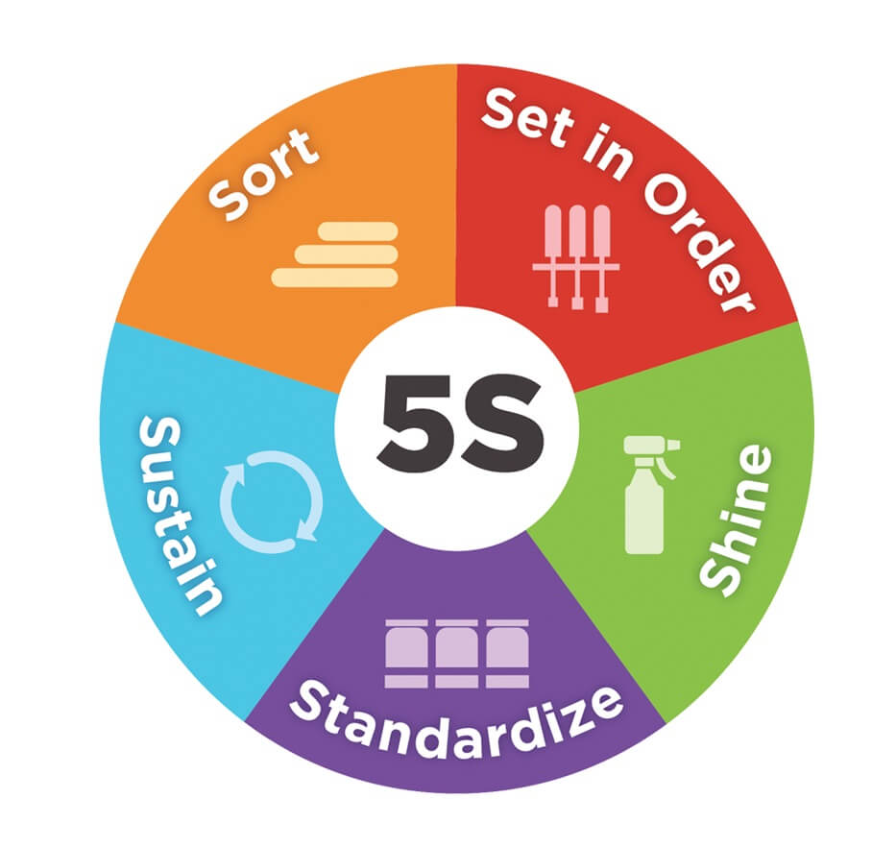
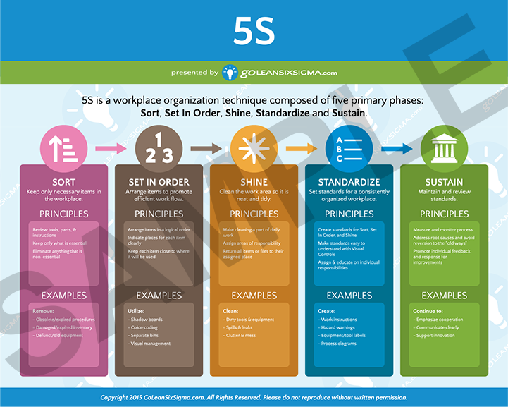
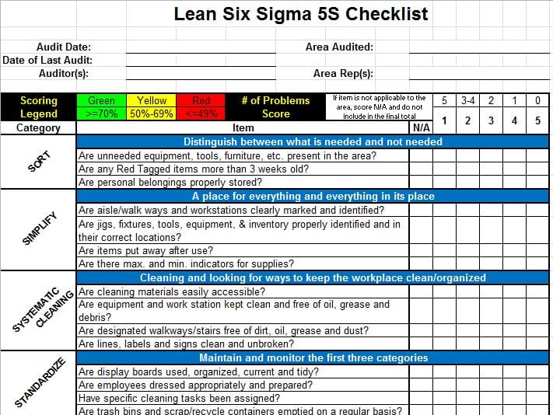
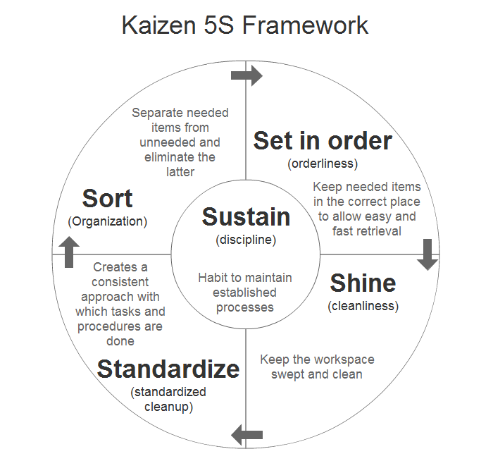
5S Charts

Slide 9
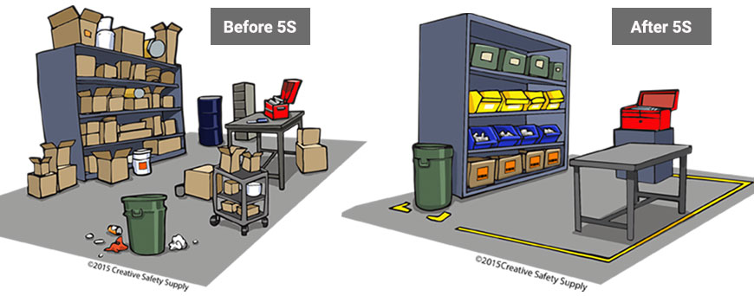
5S Example
Sort/segregate
Simplify/straighten
Shine/sweep
Standardize
Sustain/self-discipline

Slide 10
Lean Operations
Just-in-time (JIT) focuses on continuous forced problem solving
Toyota Production System (TPS) emphasizes continuous improvement, respect for people, and standard work practices in an assembly-line environment

Slide 11
Lean Operations
Encompasses JIT, TPS, Kanban…
Sustains competitive advantage and increases return to stakeholders
Three fundamental issues
Eliminate waste
Remove variability
Improve throughput

Slide 12
Lean and Just-In-Time
Powerful strategy for improving operations
Materials arrive where they are needed only when they are needed
Identifying problems and driving out waste reduces costs and variability and improves throughput
Requires a meaningful buyer-supplier relationship

Slide 13
Supplier Partnerships
Exist when a supplier and purchaser work together to remove waste and drive down costs
Four goals of supplier partnerships are:
Removal of unnecessary activities
Removal of in-plant inventory
Removal of in-transit inventory
Improved quality and reliability

Slide 14
Concerns of Suppliers
Need
Collaboration, Mutual understanding, and Trust
Diversification
Ties to only one customer increases risk
Scheduling
Don't believe customers can create a smooth schedule
Lead time
Short lead times mean engineering or specification changes can create problems
Quality
Limited by capital budgets, processes, or technology
Lot sizes
Small lot sizes may transfer costs to suppliers

Slide 15
Lean Scheduling
Better scheduling improves performance
TABLE 16.3
LEAN SCHEDULING TACTICS
Make level schedules
Use kanbans
Communicate schedules to suppliers
Freeze part of the schedule
Perform to schedule
Seek one-piece-make and one-piece-move
Eliminate waste
Produce in small lots
Make each operation produce a perfect part

Slide 16
Lean Layout
Reduce waste due to movement
TABLE 16.1
LEAN LAYOUT TACTICS
Build work cells for families of products
Include a large number operations in a small area
Minimize distance
Design little space for inventory
Improve employee communication
Use poka-yoke devices
Build flexible or movable equipment
Cross-train workers to add flexibility

Slide 17
Lean Inventory
Inventory is at the minimum level necessary to keep operations running
TABLE 16.2
LEAN INVENTORY TACTICS
Use a pull system to move inventory
Reduce lot sizes
Develop just-in-time delivery systems with suppliers
Deliver directly to point of use
Perform to schedule
Reduce setup time
Use group technology

Slide 18
Reduce Lot Sizes
Ideal situation is to have lot sizes of one pulled from one process to the next
Often not feasible
Can use EOQ analysis to calculate desired setup time
Two key changes necessary
Improve material handling
Reduce setup time

Slide 19
Setup Time Example
D = Annual demand = 400,000 units
d = Daily demand = 400,000/250 = 1,600 per day
p = Daily production rate = 4,000 units
Q_{p} = EOQ desired = 400 units
H = Holding cost = $20 per unit
S = Setup cost (to be determined)
R = Hourly rate for setup personnel = $30
Setup time = $2.40/($30/hour) = 0.08 hr = 4.8 minutes

Slide 20
Reduce Setup Costs
High setup costs encourage large lot sizes
Reducing setup costs reduces lot size and reduces average inventory
Setup time can be reduced
Preparation prior to shutdown
Changeover

Slide 21
Lean Scheduling
Schedules must be communicated inside and outside the organization
Level schedules
Process frequent small batches
Freezing the schedule helps stability
Kanban
Signals used in a pull system

Slide 22
Kanban
Japanese word for card
The card is an authorization for the next container of material to be produced
A sequence of kanbans pulls material through the process
Many different sorts of signals are used, but the system is still called a kanban

Slide 23
Kanban
When there is visual contact
The user removes a standard-size container of parts from a small storage area, as shown in Figure 16.8.
The signal at the storage area is seen by the producing department as authorization to replenish the using department or storage area. Because there is an optimum lot size, the producing department may make several containers at a time.

Slide 24
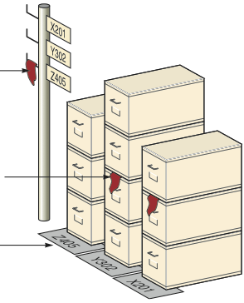
Kanban
Figure 16.8
Signal marker hanging on post for part Z405 shows that production should start for that part. The post is located so that workers in normal locations can easily see it.
Signal marker on stack of boxes
Part numbers mark location of specific part

Slide 25
Kanban
When the producer and user are not in visual contact, a card can be used; otherwise, a light or flag or empty spot on the floor may be adequate
Usually each card controls a specific quantity of parts although multiple card systems may be used if there are several components or if the lot size is different from the move size

Slide 26
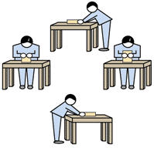
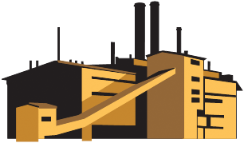
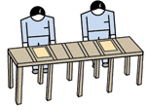


Kanban
Product Flow
❶ START ------------------------------ Pull System ------------------------------ END ❷
Material/Parts Supplier
Final assembly
Finished goods
Customer order
Work cell
Kanban
Kanban
Kanban
Information Flow
❷ END ------------------------------ Pull System ------------------------------ START ❶

Slide 27
The Number of Kanban Cards or Containers
Need to know the lead time needed to produce a container of parts
Need to know the amount of safety stock needed
Demand during Safety lead time + stock
Size of container
Number of kanbans
(containers)
=

Slide 28
Number of Kanbans Example
Daily demand = 500 cakes
Production lead time = 2 days
(Wait time +
Material handling time +
Processing time)
Safety stock = 1/2 day
Container size = 250 cakes
Demand during lead time = 2 days x 500 cakes = 1,000
Safety stock = ½ x Daily demand = 250
1,000 + 250
250
Number of kanbans = = 5

Slide 29
Advantages of Kanban
Small containers require tight schedules, smooth operations, little variability
Shortages create an immediate impact
Places emphasis on meeting schedules, reducing lead time and setups, and economic material handling
Standardized containers reduce weight, disposal costs, wasted space, and labor

Slide 30
Lean Quality
Strong relationship
Lean cuts the cost of obtaining good quality because Lean exposes poor quality
Because lead times are shorter, quality problems are exposed sooner
Better quality means fewer buffers and allows simpler Lean systems to be used

Slide 31
Lean Quality Tactics
TABLE 16.4
LEAN QUALITY TACTICS
Use statistical process control
Empower employees
Build fail-safe methods (poka-yoke, checklists, etc.)
Expose poor quality with small lots
Provide immediate feedback

Slide 32
Toyota Production System
Continuous improvement
Build an organizational culture and value system that stresses improvement of all processes, kaizen
Part of everyone’s job
Respect for people
People are treated as knowledge workers
Engage mental and physical capabilities
Empower employees
“Not my job” = Never
Stopping production because of a defect is called jidoka

Slide 33
Toyota Motor Corporation
Success due to two techniques, JIT and TPS
Continual problem solving is central to JIT
Eliminating excess inventory makes problems immediately evident
Central to TPS is employee learning and a continuing effort to produce products under ideal conditions
Respect for people is fundamental
Small building but high levels of production
Subassemblies are transferred to the assembly line on a JIT basis
High quality and low assembly time per vehicle

Slide 34
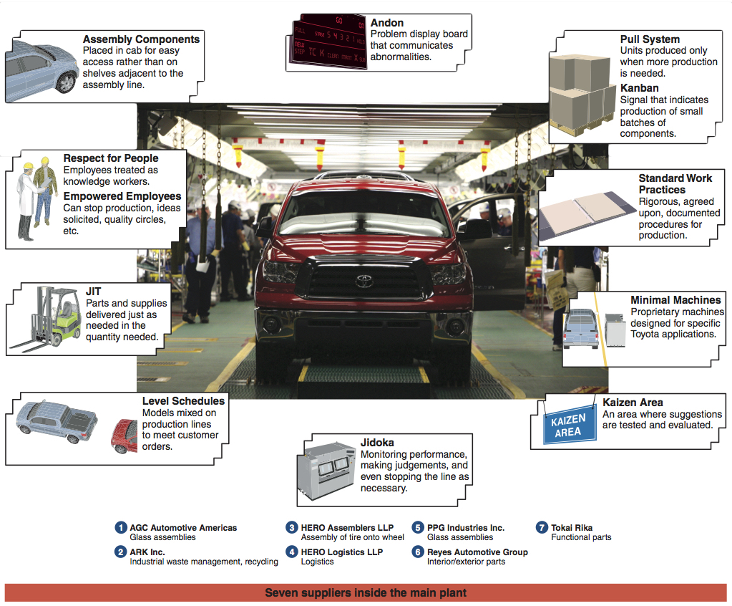
TPS Elements
https://www.youtube.com/watch?v=cAUXHJBB5CM

Slide 35
Lean Organizations
Understanding the customer and their expectations
Functional areas communicate and collaborate to make sure customer expectations are met
Implement the tools of Lean throughout the organization

Slide 36
Building a Lean Organization
Transitioning to a Lean system can be difficult
Build a culture of continual improvement
Open communication
Demonstrated respect for people
Gemba walks to see work being performed
Japanese term meaning "the real place"

Slide 37
Building a Lean Organization
Lean systems tend to have the following attributes
Respect and develop employees
Empower employees
Develop worker flexibility
Develop collaborative partnerships with suppliers
Eliminate waste by performing only value-added activities

Slide 38
Lean in Services
The Lean techniques used in manufacturing are used in services
Report generation
Service time
Staffing numbers

Slide 39
Process Improvement
Lean is implemented through process improvement events
Goal = investigate one business or technical process or function
How = Many meetings
Map out current issues
Plan potential solutions
Implement solutions
Monitor progress
Determine if further improvement needed

